Slide 1
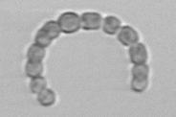

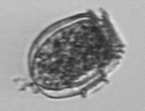

Input
Preprocess
Feature Learning: ResNet-18
Classification
Output Labels
fully
connected
SoftMax
(38 classes)
Conv + BN + ReLU
Pooling
Conv block
ID block
Uncertain
Resized & Padded Phytoplankton Images
HAB classes
+ augmentation (training only)
Non-HAB classes
IFCB images
Stage 1
Stage 2
Stage 3
Stage 4
Stage 5
original width, height, and aspect ratio → joined with CNN features

